Slide 1

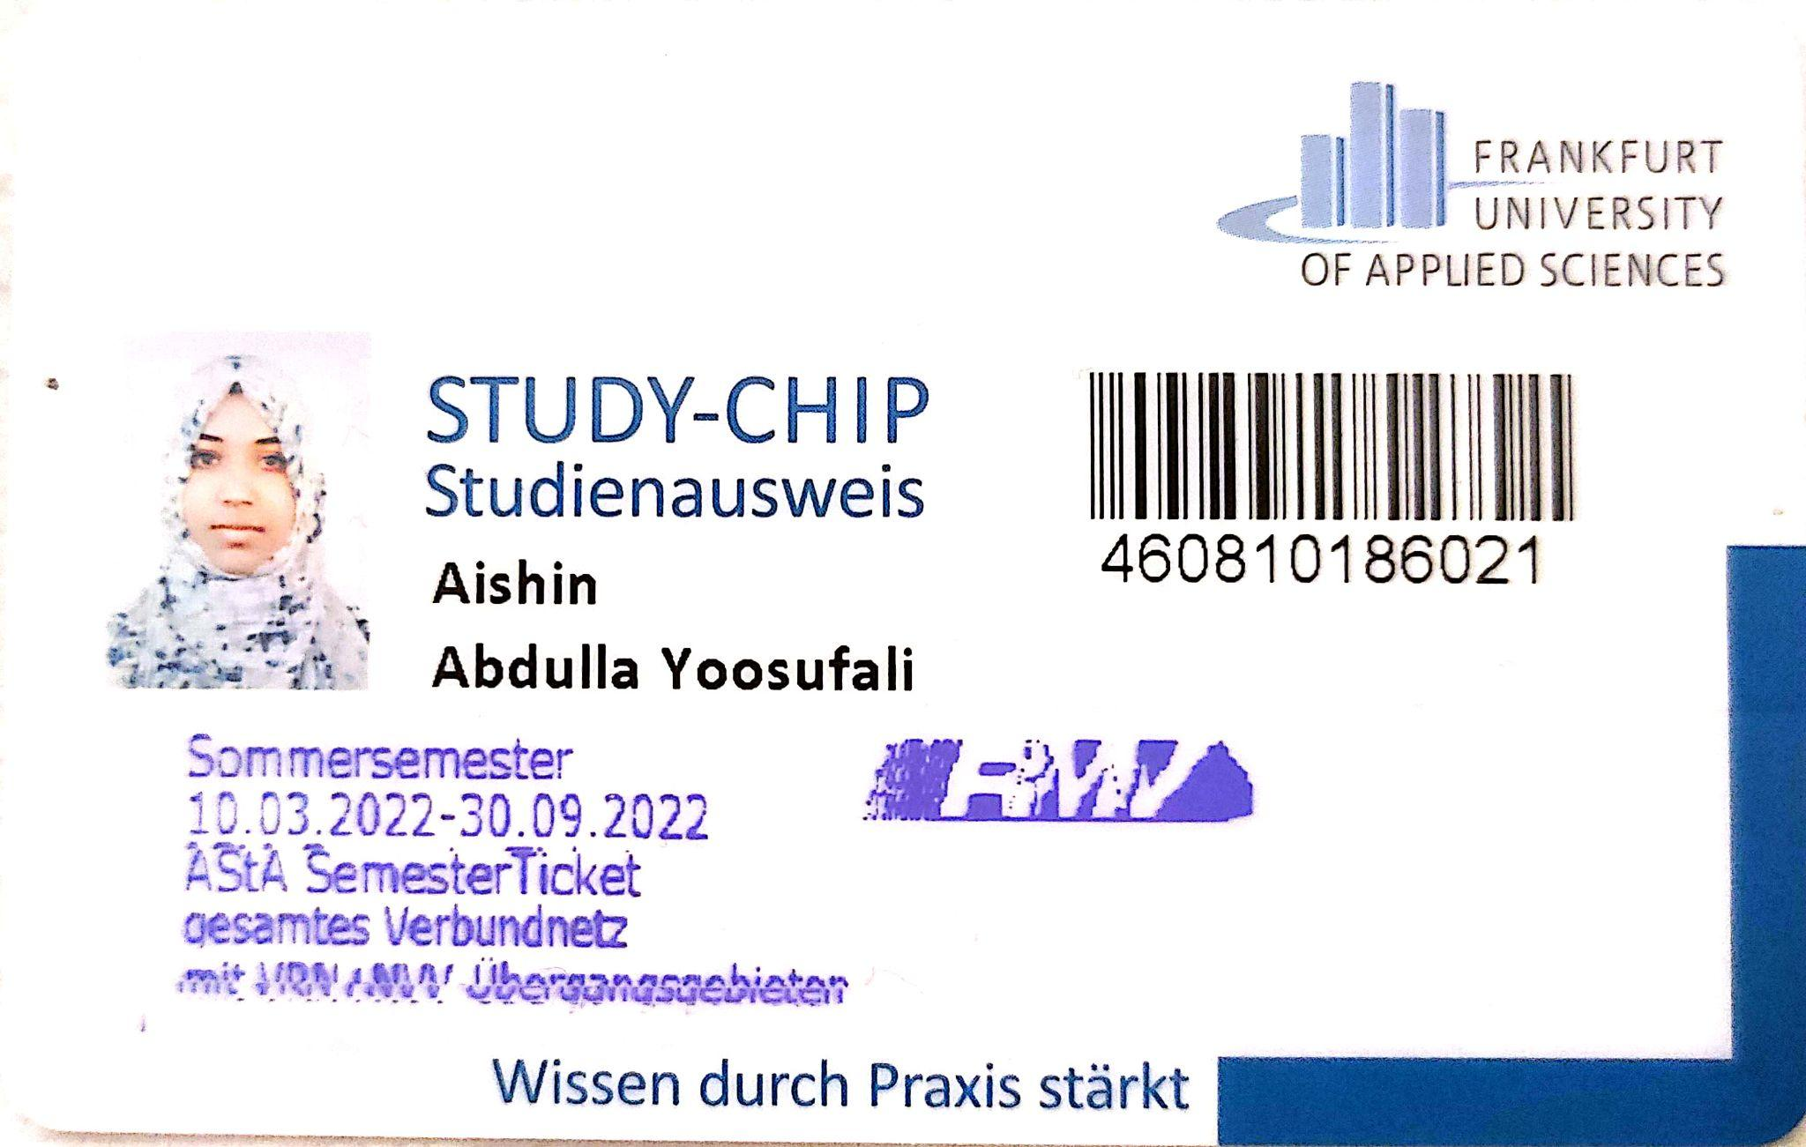
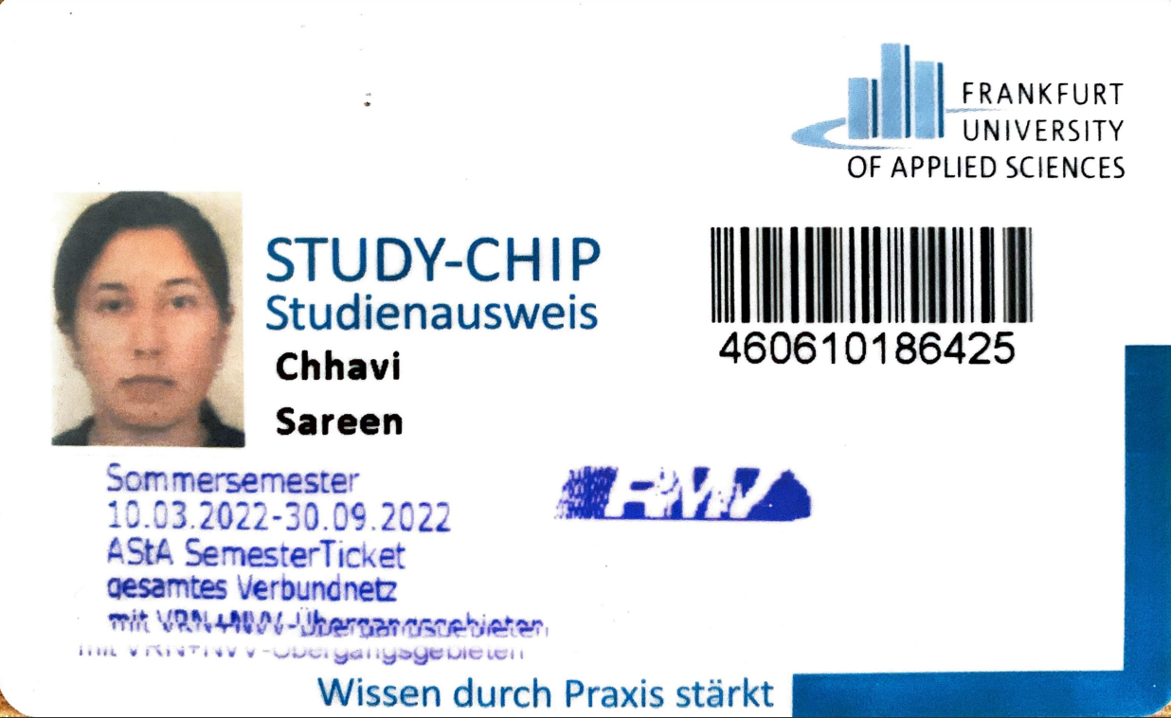
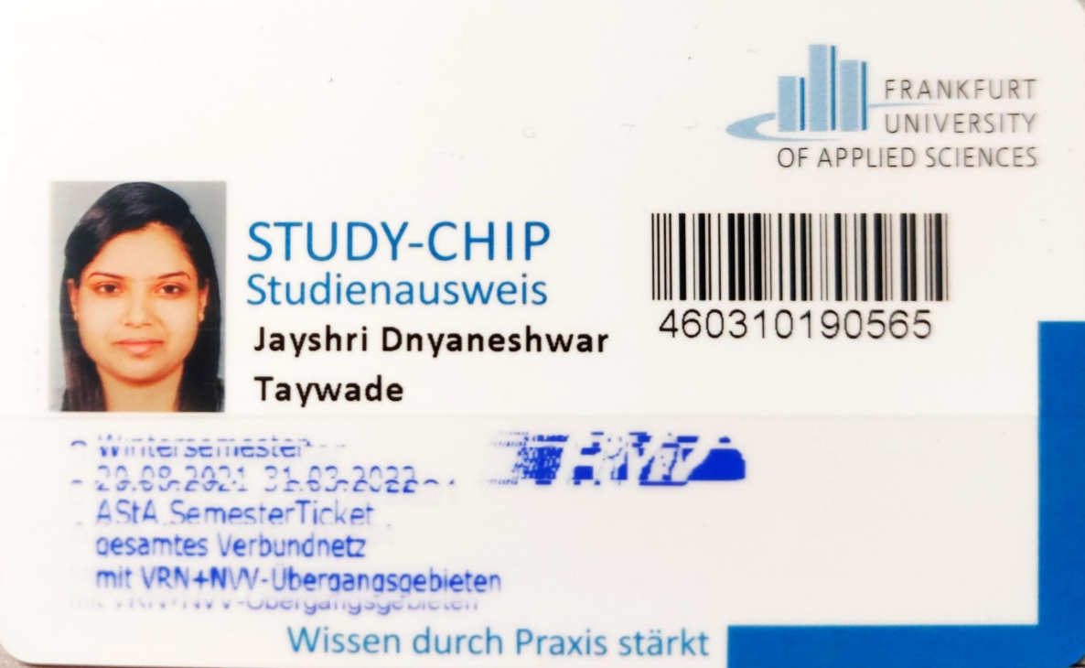
Networking Approach:SDN//Service:Text-based Chats
Masters in Information Technology
Mobile Computing
By Prof. Armin Lehmann
Aishin Abdulla Yoosufali Chhavi Sareen Jayshri Taywade
1359022 1360105 1343384
aishin.abdullayoosufali@stud.fra-uas.de chhavi.sareen@stud.fra-uas.de jayshri.taywade@stud.fra-uas.de

Slide 2

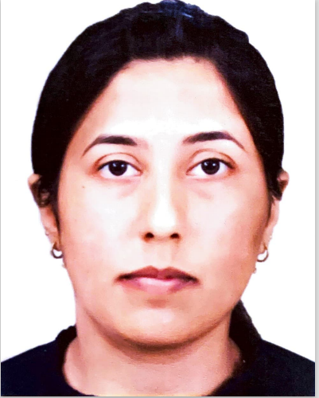

Aishin Abdulla Yoosufali Chhavi Sareen Jayshri Taywade

Slide 3
INTRODUCTION
Software-Defined Network is a current trend in computer network research. On computer network devices, SDN offers a control-plane and data-plane separation paradigm.
SDN is a new networking paradigm that promises to overcome current network infrastructure restrictions.
1) First, it separates the network's control logic from the underlying routers and switches that forward traffic.
2)Second, because the control and data planes are separated, network switches become simple forwarding devices, and control logic is implemented in a logically centralized controller.
Network slices, by definition, are end-to-end logical networks that run on top of shared network infrastructure
The concept of network slicing is naturally supported by the SDN architecture

Slide 4
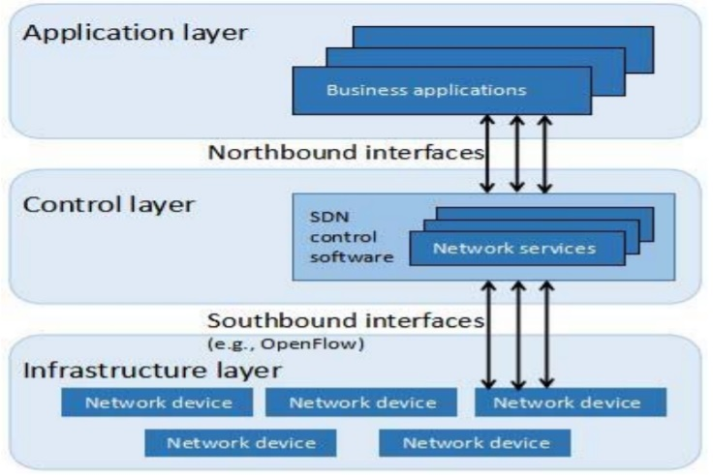
SDN Architecture

Slide 5
OpenFlow Switch
OpenFlow is the most widely used SDN protocol.
One or more flow tables are maintained by each OpenFlow-compliant switch and are used to perform packet lookups.
Using the OpenFlow protocol, the controller will manage the switch.
OpenFlow communicate with one another logically through their OpenFlow ports.

Slide 6
Network Slicing
Network slicing is a key technology for the impending 5G system.
It allows operators to organize network resources flexibly while providing a variety of services to subscribers and third-party clients.
Control and forwarding planes are decoupled in SDN, and control is moved to a centralized controller.
Network virtualization (NV) uses containers to divide functions.

Slide 7
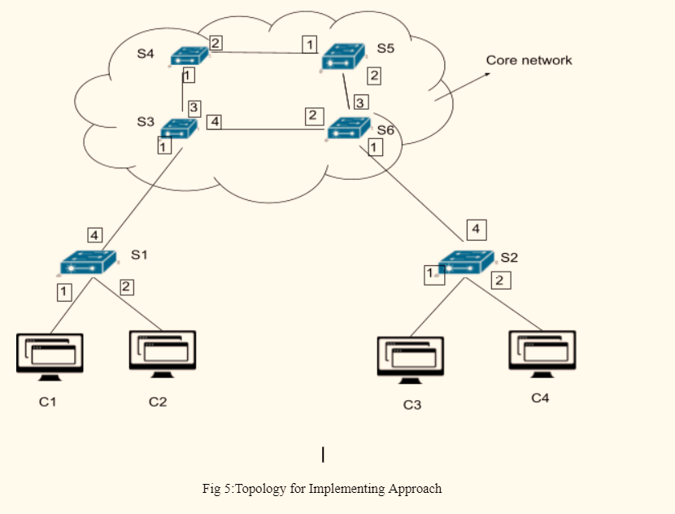
Approach Followed

Slide 8
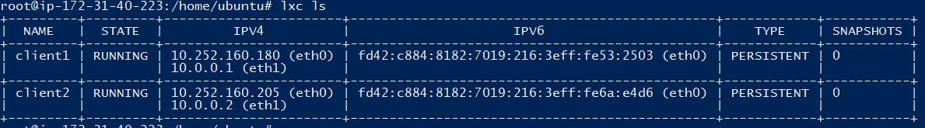
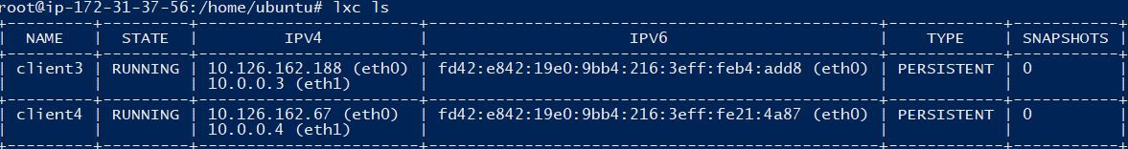
Implementation
Access Network A:
Client 1 is connected via eth1 port and client2 is connected via eth1 port to switch1
Access Network B:
Client 3 is connected via eth1 & client 4 is connected via eth1 port to switch ports

Slide 9
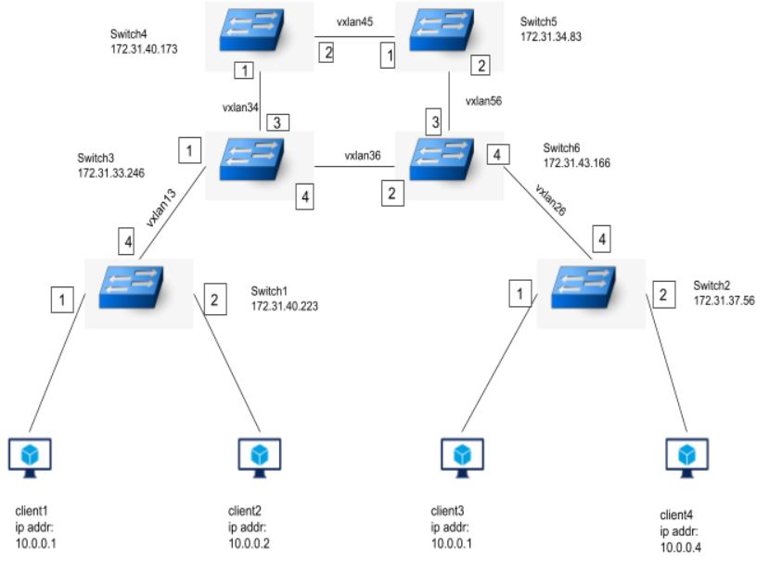
Implementation
SDN Architecture using Open vSwitches, OpenFlow Protocol & Tunneling

Slide 10
Implementation
Four Open vSwitches are used to create the transport network, and in all switches OpenFlow is enabled.
Every switches have a flow rules that will be implemented when we do a packet transmission from client1 to client3 or we can say network slicing
We have set the rule from swtich1 and switch2 ports to drop the transfer of packet to client2 and client4 ports.
For the interconnection of switches, we have used VxLAN tunneling mechanism

Slide 11
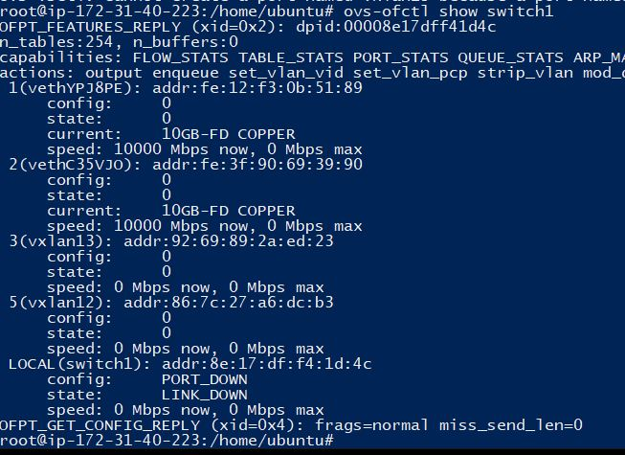
Implementation
Configuration of OpenFlow in Switch1:

Slide 12
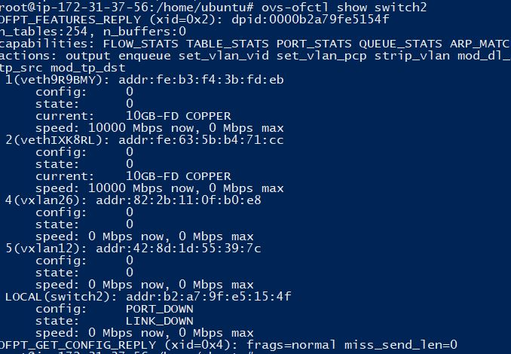
Implementation
Configuration of OpenFlow in Switch2:

Slide 13
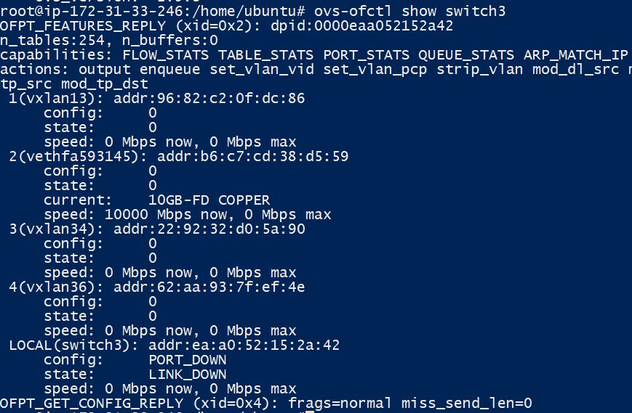
Implementation
Configuration of OpenFlow in Switch3:

Slide 14
Implementation
Flow Table os Switch1:
Flow Table os Switch2:

Slide 15
Thank You

